Slide 1
(Partially) Non-Learnable
Variational AutoEncoders
Mick IJzer
Supervisor: Jakub Tomczak

Slide 2
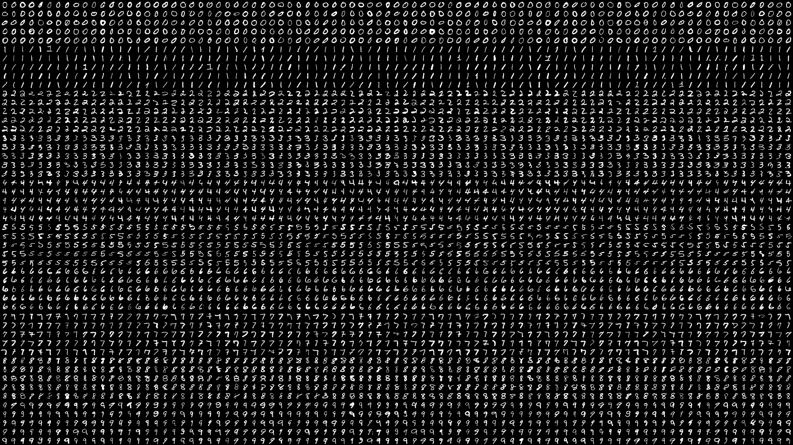
MNIST:
Data Set

Slide 3
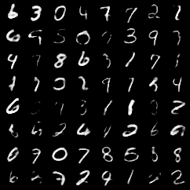
MNIST: Generated Images

Slide 4
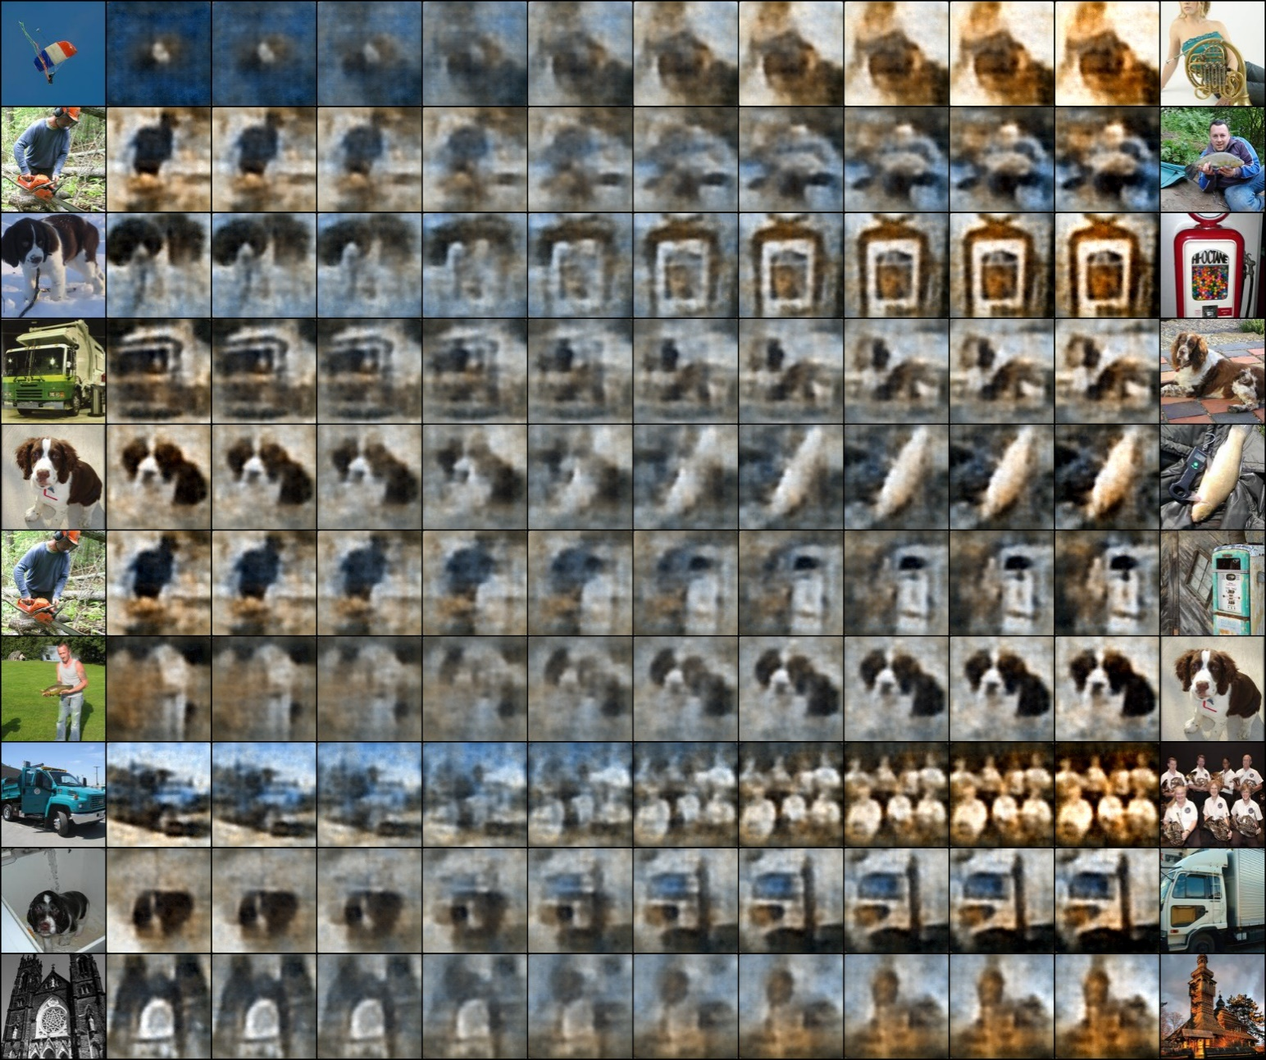
Imagenette:

Slide 5
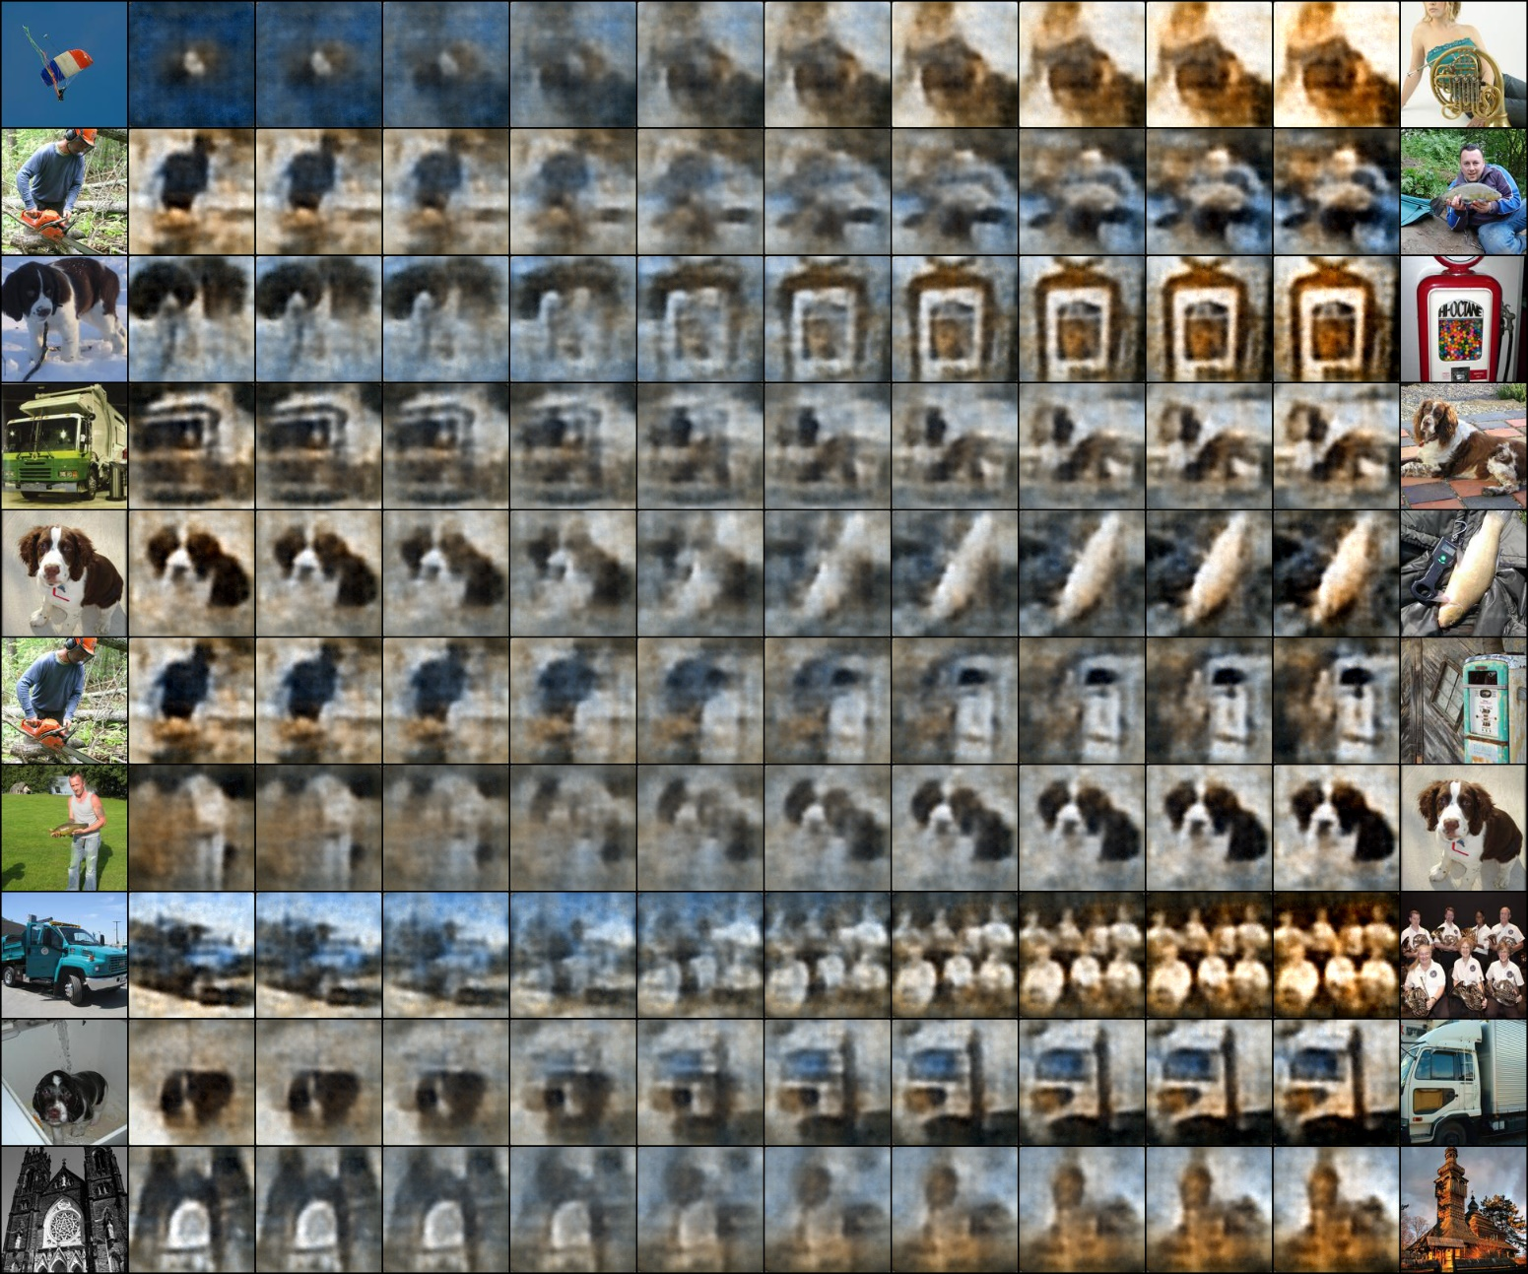
Imagenette:
Reconstruction

Slide 6
Imagenette:
Interpolation

Slide 7
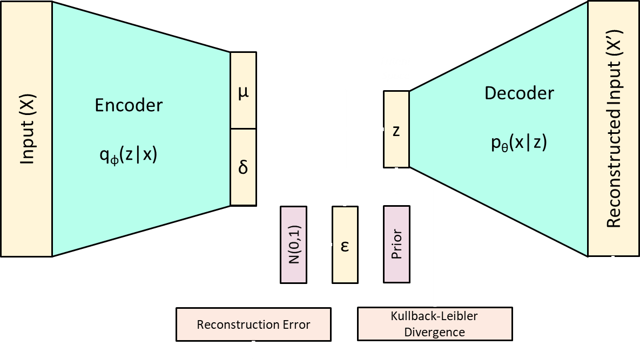
Variational AutoEncoder
Generative Adverserial Network
Adverserial Loss (1)
True Sample
Input
Discriminator
q_{φ}(z|x)
p
Latent
Space
Generator
p_{θ}(x|z)
Generated Sample
N(0, 1)
z
Adverserial Loss (1)
Generative Models

Slide 8
Scalar
Vector
Input (X)
Reconstructed Input (X’)
Neural Network
Encoder
q_{φ}(z|x)
Decoder
p_{θ}(x|z)
Latent
Space
Distribution
z
Reconstruction Error
AutoEncoder

Slide 9
Scalar
Vector
Input (X)
Reconstructed Input (X’)
Neural Network
Encoder
q_{φ}(z|x)
Decoder
p_{θ}(x|z)
µ
µ
Latent
Space
Distribution
Latent Distr.
z
δ
δ²
Prior
Reconstruction Error
Kullback-Leibler Divergence
Variational AutoEncoder

Slide 10
Scalar
Vector
Input (X)
Reconstructed Input (X’)
Neural Network
Encoder
q_{φ}(z|x)
Decoder
p_{θ}(x|z)
µ
µ
Latent
Space
Distribution
z
δ
δ²
N(0,1)
ε
Prior
Reconstruction Error
Kullback-Leibler Divergence
Reparameter-ization Trick

Slide 11
Problem Statement
Wei, R. Garcia, C., El-Sayed, A., Peterson, V. & Mahmood, A. (2020). Variations in Variational Autoencoders - A Comparative Evaluation. IEEE Acces, vol. 9, pp. 153651-153670.

Slide 12
Scalar
Vector
Input (X)
Neural Network
Encoder
q_{φ}(z|x)
µ
Distribution
δ
Baseline

Slide 13
Scalar
Vector
Input (X)
Input (X)
Neural Network
Neural Network
q_{φ}(z|x)
Random
Kitchen Sinks
q_{φ}(z|x)
µ
µ
Distribution
Non-Learnable Transformations
δ
δ
Non-Learnable Encoders

Slide 14
Scalar
Vector
Input (X)
Input (X)
Neural Network
Neural Network
q_{φ}(z|x)
Random
Kitchen Sinks
q_{φ}(z|x)
z
z
Distribution
Non-Learnable Transformations
Non-Learnable Encoders

Slide 15
Scalar
Vector
Input (X)
Input (X)
Neural Network
Neural Network
q_{φ}(z|x)
Random
Kitchen Sinks
q_{φ}(z|x)
z
Cosine
z
Cosine
Distribution
Non-Learnable Transformations
Non-Learnable Encoders

Slide 16
Scalar
Vector
Input (X)
Input (X)
Neural Network
Neural Network
q_{φ}(z|x)
Random
Kitchen Sinks
q_{φ}(z|x)
Single Layer
µ
Single Layer
µ
Distribution
Non-Learnable Transformations
δ
δ
Partially Learnable Encoders

Slide 17
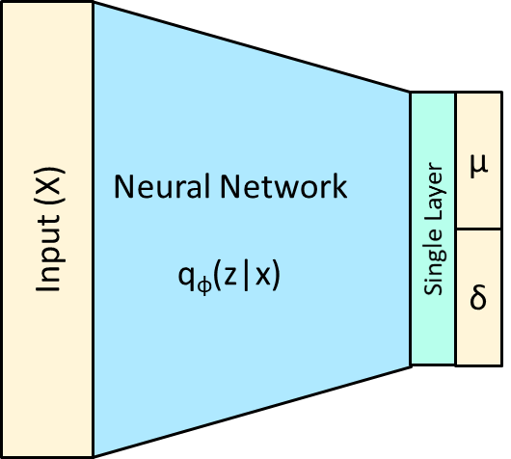
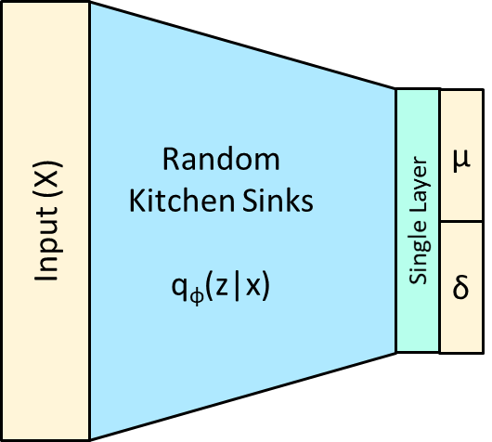
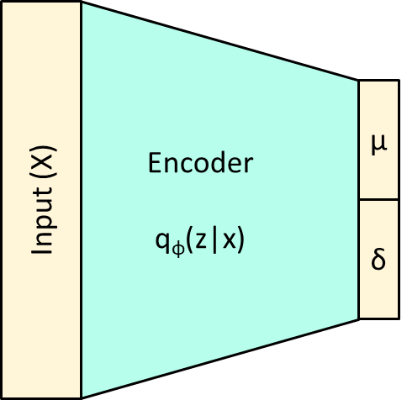
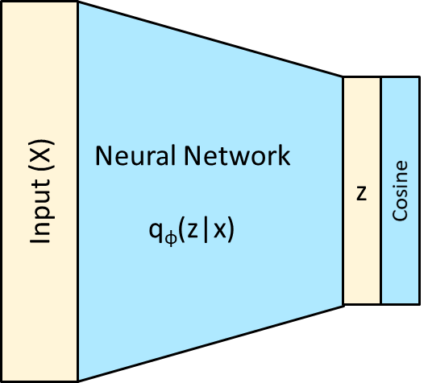
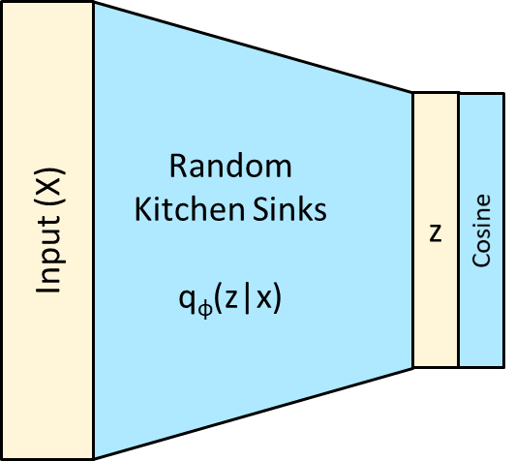
Scalar
Vector
Neural Network
Distribution
Non-Learnable Transformations
Overview

Slide 18
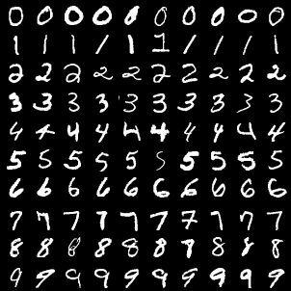
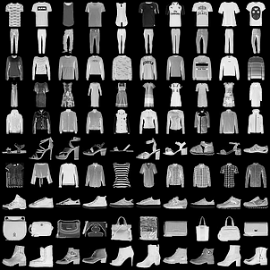
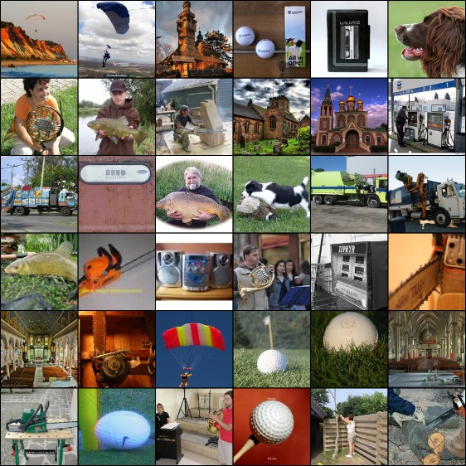
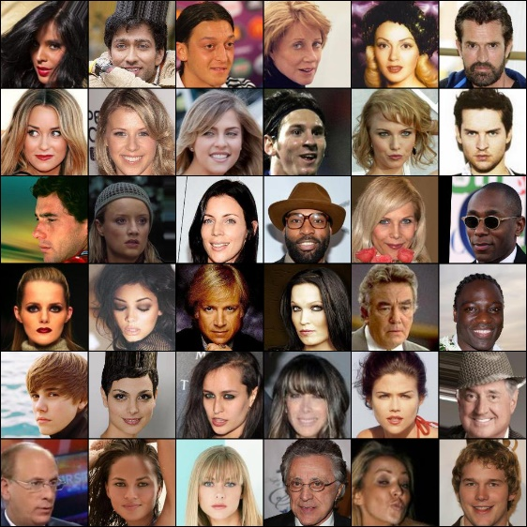
Data Sets

Slide 19
Model Complexity
Computation Speed
Reconstruction Error
FID-score
Evaluation Metrics

Slide 20
Questions?

Slide 24
Input
Filter
Output

Slide 25
Weight Matrix
Input
Output

Slide 26
X_{a}
Y_{a}
Z_{a}
X_{b}
f
Y_{b}
Z_{b}
Input
Coupling
Permutation
Output

